Slide 1


Risk Controls Group
Report Date - July 12, 2000
Confidential

Slide 2
Risk Controls Group
Project Objective:
Our review was designed to identify and test key policies, procedures, and controls related to the 1) compilation of the Daily Position Report and consolidation/creation of V@R, 2) production of the Benchmark Report,
3) validation of curves created by individual business segments, and
4) identification and notification of limit violations.
AA Team Members: Enron Team Members:
Tom Bauer Mike Moscoso
Ed Hill Beth Perlman
Michael Schultz Andrew Parsons
Kate Agnew Chris Abel Cindy Davis Gary Stadler
Russ Bouwhuis Kristin Walsh
Jennifer Muse Gabriel Monroy
Linda Norman Rahmaan Mwongozi
Jack Ehrig
Sean Sipko

Slide 3
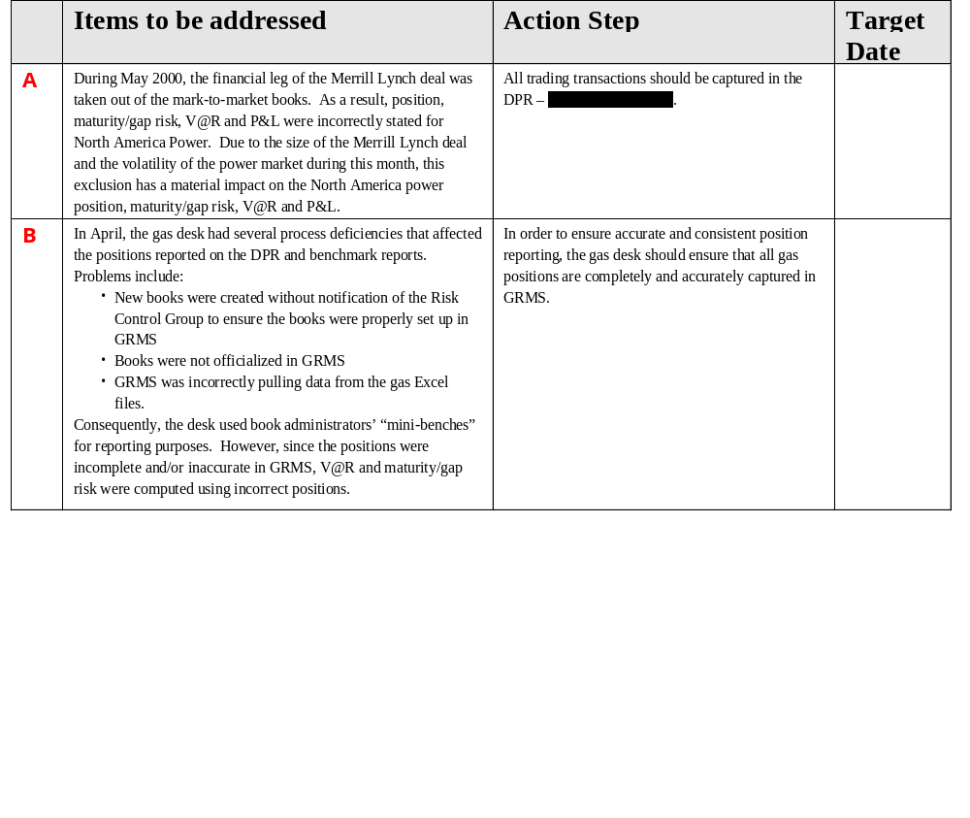
Risk Controls Group Observations - Process

Slide 4
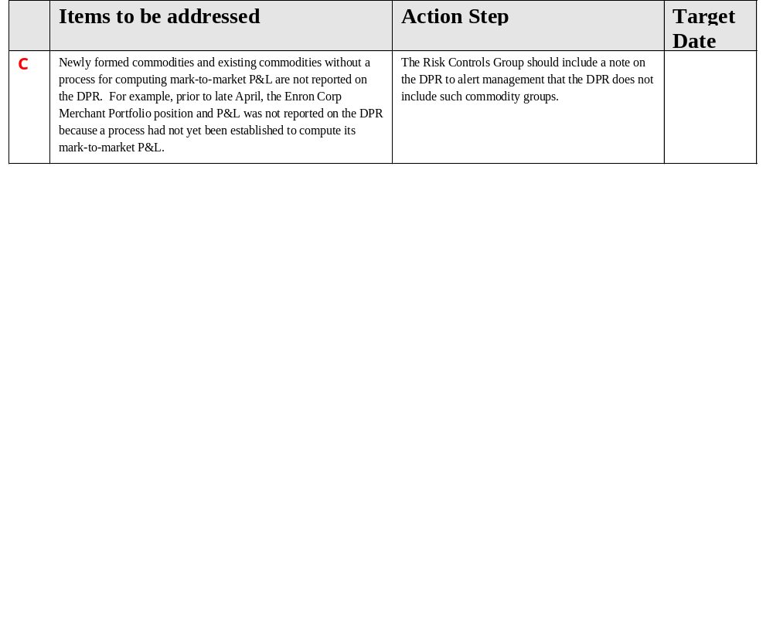
Risk Controls Group Observations - Process

Slide 5
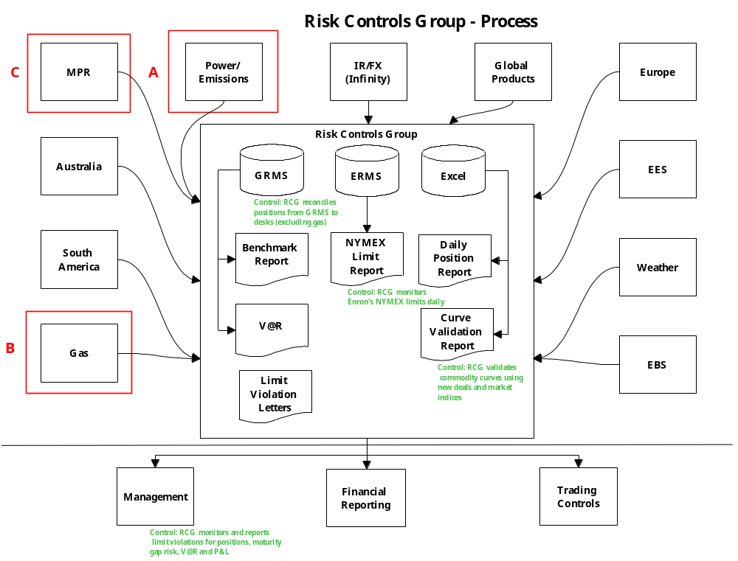

Slide 6
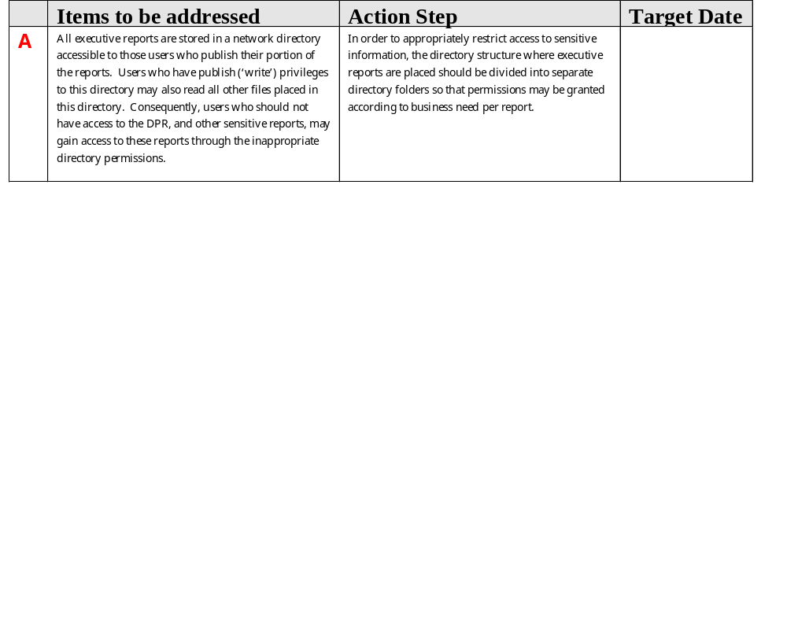
Risk Controls Group Observations - Systems

Slide 7
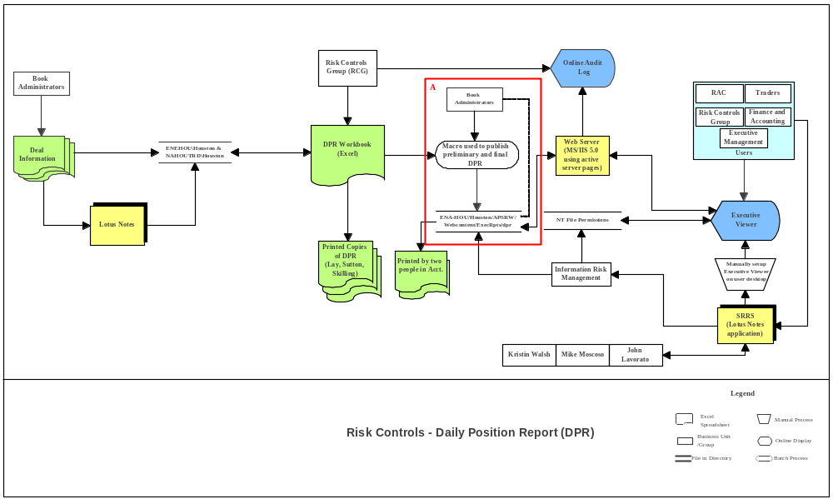
Risk Controls Group - Systems

Slide 8
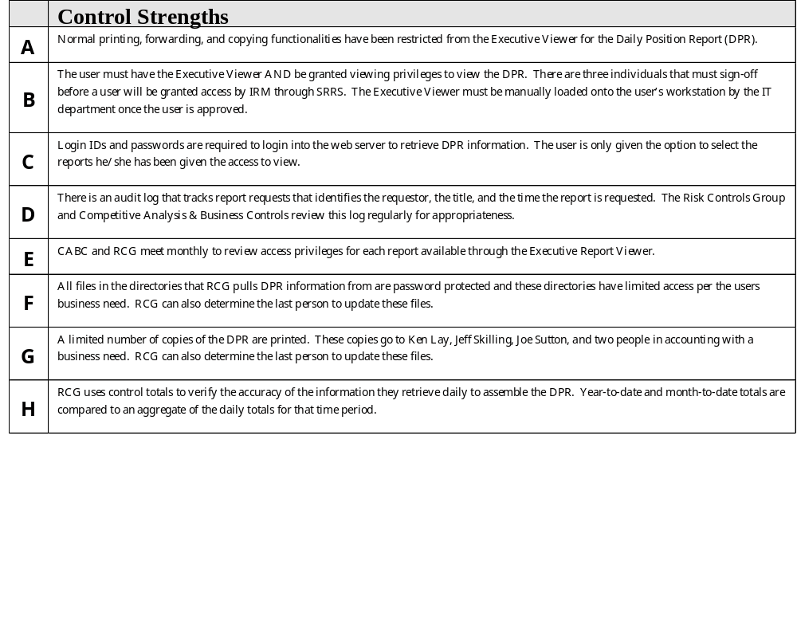
Risk Controls Group Observations

